Slide 1
Project 2 –Unit 3A
Where were you last weekend?

Slide 2
Textbook; 32/1 Vocabulary
1 on holiday g
2 at a wedding d
3 in the garden b
4 at work f
5 on the beach h
6 in bed a
7 at a theme park e
8 at home c

Slide 3
Textbook; 32/2
Conor and Clare were at a theme park.
Azra was on holiday in Croatia with her family.
Henry was at his cousin´s wedding.
Mr Riley was in bed all weekend because he was ill.

Slide 4
Textbook; 33 – grammar – past simple: be (byl jsem; byli....)
I was - já jsem byl(a)
You were
He was
She was
It was
We were
They were
I was not/wasn´t
You were not/weren´t
He was not/wasn´t
She was not/wasn´t
It was not/wasn´t
We were/weren´t
They were/weren´t

Slide 5
Textbook; 33/4a - was x were
2. We were on a school trip yesterday.
3. My dad was at work last week.
4. You were away at the weekend.
5. Azra was in Croatia for two weeks.
6. She was on the beach every day.
7. Our neighbours were on holiday last week.
8. Mr Riley was ill yesterday.

Slide 6
Textbook; 33/5 - questions with was/were
Was he here last week? Yes, he was./No, he wasn´t.
Were they at a theme park? Yes, they were./No, they weren´t.

Slide 7
Textbook; 33/7a
1. was
2. weren´t
3. were
4. was
5. wasn´t
6. wasn´t
7. were
8. weren´t
9. was
10.wasn´t
11.was
12. were

Slide 8
Textbook; 33/7b
1. She was with her parents.
2. They weren´t in a big hotel. They were in an apartment.
3. It wasn´t near Dubrovnik. It was near Split.
4. It wasn´t next to the beach, but the beach wasn´t very far.
5. The other children weren´t from Britain. They were from Germany, Hungary and Slovakia.
6. One of the boys wasn´t from Poland. He was from Slovakia.

Slide 9
7. The weather wasn´t bad for five days. It was bad for the first two days.
8. Azra wasn´t in Croatia for two weeks. She was there for ten days.

Slide 10
Workbook; 24/1 - at x in x on
2. at a theme park
3. at a wedding
4. in bed
5. on the beach
6. in the garden

Slide 11
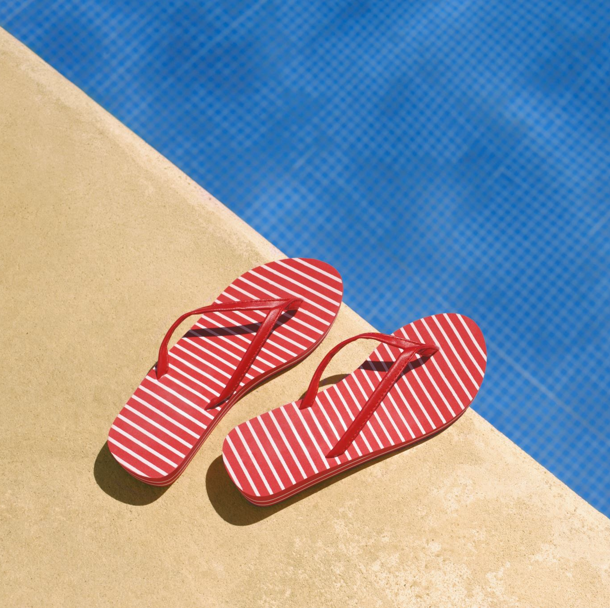
Workbook; 24/2
2. swimming pool
3. cinema
4. animals
5. five
6. thirteen
7. eleven

Slide 12
Workbook; 24/3 was x were
2. were
3. was
4. was
5. was
6. were
7. were
8. was
9. were
10.were
11.were
12.was
13.was
14.was

Slide 13
15.was
16.were
17. was

Slide 14
Workbook; 25/4
2. Andrew wasn´t at his sister´s wedding. He was at a theme park.
3. Our teacher wasn´t at work. She was on holiday.
4. We weren´t at the cinema. We were at a party.
5. Martha wasn´t at the shops. She was in bed.
6. Sally and Josh weren´t at a birthday party. They were at a swimming pool.

